Slide 1

StockWatch User Manual
Pratyush M

Slide 2
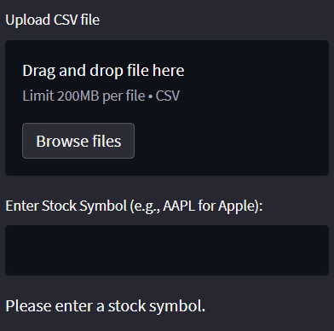
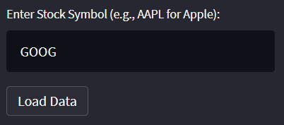
On the left hand side of the page, we have our selection between a user-uploaded file or a yahoo finance dataset from a stock symbol.
The user uploaded dataset (.csv) has to be in the same format as the yahoo finance datasets.
After we type in and enter our stock, we get a “Load Data” symbol, which imports the dataset when pressed.

Slide 3


We are then presented with a table of the loaded data
And another table with forecasted values
And two graphs/charts showing the ARIMA and SARIMAX forecasts.

